Slide 1
Credit Score Classification Using Machine Learning
By: Vatsal Sivaratri

Slide 2
Problem Statement and Motivation
Goal: Develop a predictive, robust model(s) for classifying individuals' credit scores.
Motivation: There is a growing need for transparency and accuracy in evaluating trustworthiness of Credit Card users. A strong relationship between banks and their customers is necessary for a productive economy. The hope is to use past data on credit card holders to predict the likelihood of a good credit score in new customers, by considering a variety of attributes.

Slide 3
Dataset Source & Description
Source: Kaggle Card ScoreDataset
Key Details: Training dataset consists of 100,000 instances and 27 features, including both numerical and categorical.
Features: Age, Occupation, Annual_Income, Monthly_Inhand_Salary, Outstanding_Debt, Credit_Mix, etc.
Data was already split into training and testing set, but additional preprocessing was required to clean and handle inconsistencies. Only training set was used as it had enough samples.
3 different classes of Credit_Score: Good, Poor, and Standard

Slide 4
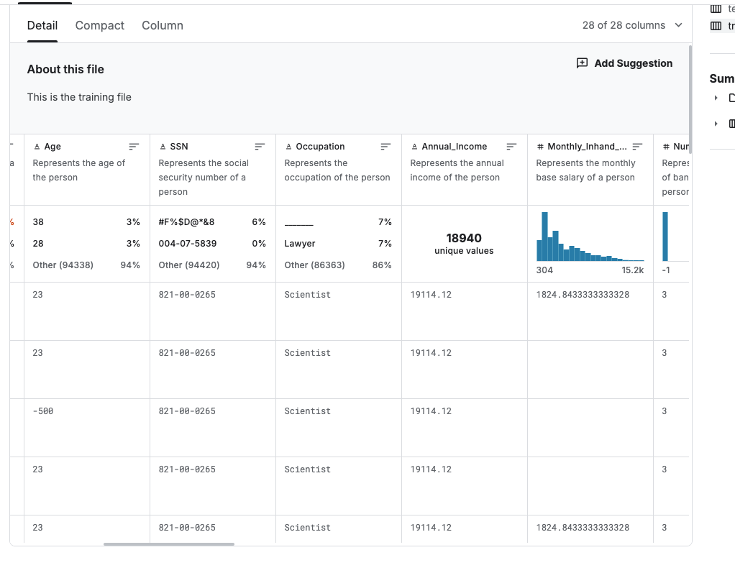
Data Types and Important Features
Numerical Data: Features like Annual_Income, Outstanding_Debt, and Credit_Utilization_Ratio
Categorical Data: Features like Occupation, Credit_Mix, and Payment_Behaviour.
Many of the features were annoyingly represented as objects, meaning they had to be converted later in Python for further analysis
Understanding types of features were crucial in determining the preprocessing techniques.

Slide 5
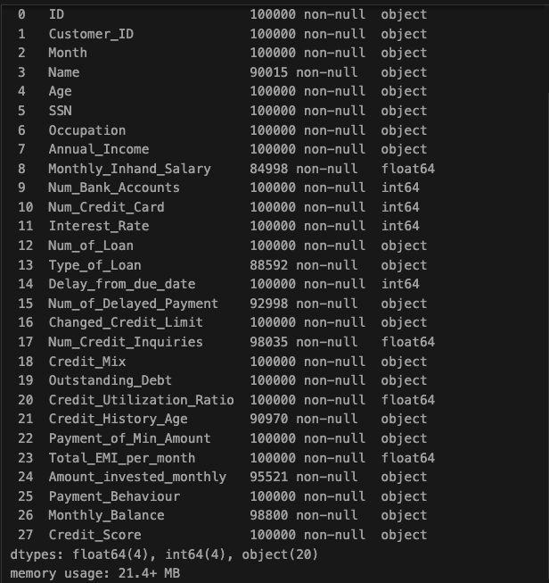
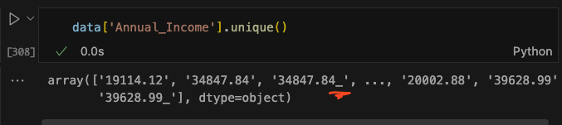
Initial Issues Found in Data
Outliers: values such as age had anomalies like negative or extremely large values (i.e. -500 and >8900 for age)
These are a part of any legitimate dataset, and represent a portion of people who chose not to answer truthfully or were incorrectly recorded
Missing Data: Several columns such as Monthly_Inhand_Salary had missing values that could skew the predictions if left unaddressed
Trailing underscores were found in several columns

Slide 6
Outlier Detection and Handling
Each feature was analyzed manually for extreme or blatantly incorrect values with simple python functions like min() and max(). They were filtered out the Pandas Dataframe with simple logical statements
For quantitative continuous variables, additional outliers were detected and removed using Interquartile Range (IQR)
…
age = pd.to_numeric(data['Age'], errors='coerce')
wrong_ages = age[(age == -500) | (age>995) | (age<18)].index
data = data.drop(wrong_ages)
data['Age'] = pd.to_numeric(data['Age'], errors='coerce')
…
Q1 = data[feature].quantile(0.25) Q3 = data[feature].quantile(0.75) IQR = Q3 - Q1 data = data[~((data[feature] < (Q1 - 1.5 * IQR)) | (data[feature] > (Q3 + 1.5 * IQR)))]

Slide 7
Missing Data Handling
For numerical columns, missing data was filled using the mean. For categorical columns, missing values were filled using the mode.
mean_columns = ['Monthly_Inhand_Salary', 'Amount_invested_monthly', 'Monthly_Balance', 'Changed_Credit_Limit']
mode_columns = ['Num_of_Delayed_Payment', 'Num_Credit_Inquiries']
categorical_mode = ['Payment_Behaviour']
for column in mean_columns:
data[column] = pd.to_numeric(data[column], errors='coerce')
data[column].fillna(data[column].mean(), inplace=True)
for column in mode_columns:
data[column] = pd.to_numeric(data[column], errors='coerce')
data[column].fillna(data[column].mode()[0], inplace=True)

Slide 8
Encoding Categorical Variables
Label Encoding: Categorical variables were converted into numerical format for models to use using Label Encoding.
toEncode = ['Month', 'Occupation', 'Credit_Mix', 'Payment_Behaviour', 'Credit_Score']
label_encoder = LabelEncoder()
for column in toEncode:
data[column] = label_encoder.fit_transform(data[column])
*The classes were also converted like this. Now, ‘Good’ is 0, ‘Poor’ is 1, and ‘Standard’ is 2.

Slide 9
Feature Engineering
Loan Columns: The original dataset had a column for Type_of_Loan that combined multiple loan types (Auto Loan, Credit-Builder Loan, Debt Consolidation Loan, Home Equity Loan, Mortgage Loan, No Loan, Not Specified, Payday Loan, Personal Loan, Student Loan). This was split into multiple binary columns
unique_loan_types = ['Auto Loan', 'Mortgage Loan', 'Personal Loan', ...]
for loan_type in unique_loan_types:
cleaned_loan_type = loan_type.replace(' ', '_').lower()
data[cleaned_loan_type] = data['Type_of_Loan'].apply(lambda x: loan_type in x if isinstance(x, str) else False)
Then ‘Auto Loan, Mortgage Loan’ => {...,Auto Loan: 1, Mortgage Loan: 1….}

Slide 10
Feature Selection Techniques
CorrelationAttributeEval: Method evaluates correlation between individual attributes and the class label (Pearson’s Correlation Coefficient). Attributes with high correlation to the class are selected (cutoff=0.10)
ReliefAttributeEval: Algorithm estimate feature importance based on how well feature can distinguish between instances that are near each other (cutoff=0.02)
ClassifierAttributeEval: Ranks features based on how well they contribute to classifier performance (I used RandomForest). Features like Annual_Income and Outstanding_Debt got prioritized here.
CfsSubsetEval: Selects group of features that work well together. Identified attributes like Num_Bank_Accounts adn Credit_Mix being most relevant for predicting credit scores.
Individually Selected Features: 'Annual_Income','Monthly_Inhand_Salary','Num_of_Loan', 'Outstanding_Debt','Credit_Utilization_Ratio','Credit_History_Age', 'Num_Credit_Card','Num_of_Delayed_Payment','Interest_Rate','Total_EMI_per_month'

Slide 11
CorrelationAttributeEval
Selected Features:
0.18151 12 Changed_Credit_Limit
0.17729 11 Num_of_Delayed_Payment
0.17391 18 Payment_of_Min_Amount
0.16813 6 Num_Bank_Accounts
0.13492 14 Credit_Mix
0.11204 8 Interest_Rate
0.10648 7 Num_Credit_Card

Slide 12
ReliefAttributeEval
Selected Features:
0.024477 2 Age
-0.021545 18 Payment_of_Min_Amount
-0.023212 14 Credit_Mix
-0.032999 21 Payment_Behaviour
-0.060802 1 Month

Slide 13
ClassifierAttributeEval
Selected Features
0.1879941 4 Annual_Income
0.1812442 15 Outstanding_Debt
0.1583674 19 Total_EMI_per_month
0.1448428 5 Monthly_Inhand_Salary
-0.1479401 20 Amount_invested_monthly
-0.1575615 22 Monthly_Balance
-0.1602462 16 Credit_Utilization_Ratio

Slide 14
CfsSubsetEval
Selected Features:
Num_Bank_Accounts
Num_of_Delayed_Payment
Changed_Credit_Limit
Credit_Mix
Payment_of_Min_Amount

Slide 15
Models
Models Evaluated: Decision Tree, Random Forest, Logistic Regression, Naive Bayes,Support Vector Machines (SVM). Evaluated using Accuracy, True Positive Rates (TPR), False Positive Rates (FPR), and ROC-AUCs
models = {
"Decision Tree": DecisionTreeClassifier(),
"Random Forest": RandomForestClassifier(),
"Logistic Regression": LogisticRegression(max_iter=1000),
"Naive Bayes": GaussianNB(),
"SVM": SVC(probability=True)
}
for model_name, model in models.items():
model.fit(X_train, y_train)
y_pred = model.predict(X_test)

Slide 16
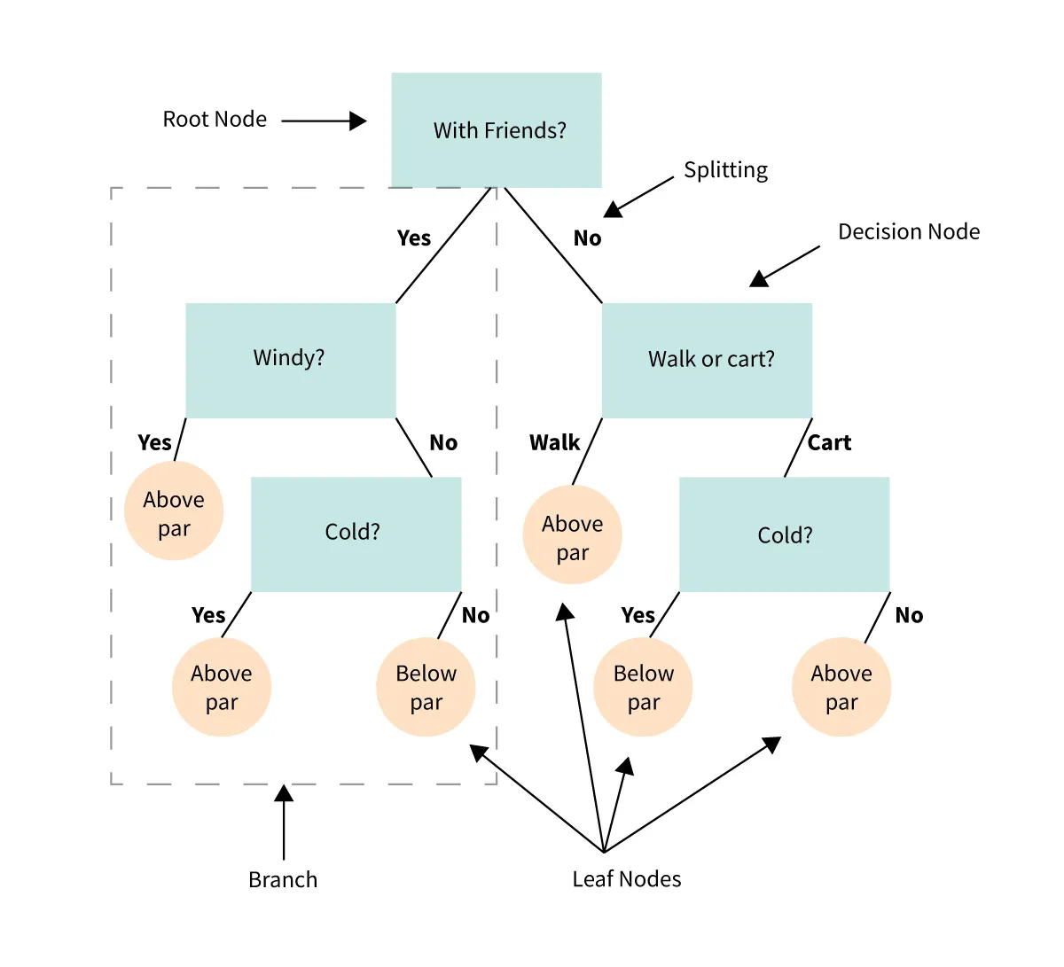
Decision Tree Classifier
Decision Trees splits data into branches based on feature values to classify data points with a sequence of actions. Structured with a root node, decision nodes, and leaf nodes.
Tree begins with root node and splits data at each node based on feature that minimizes impurity
At each node, the algorithm selects the split that yields the purest possible branches
Strengths: Interpretable and easy to visualize, can handle both numerical and categorical data.
Weaknesses: Prone to overfitting, and sensitive to small changes in data.

Slide 17

Random Forest Classifier
Random Forests combine multiple decision trees on random data subsets and combine their results for a more generalized output
Each tree is trained on a random sample of the data
Random feature selection occurs for each split point
Predictions from all trees are averaged
Strengths: Reduces overfitting by averaging multiple models, and works well with high-dimensional data
Weaknesses: Computationally intensive, low interpretability

Slide 18
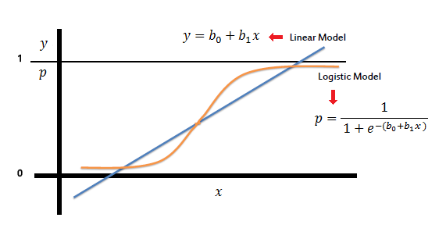
Logistic Regression
Logistic Regression is a linear model for classification, usually effective in binary cases. It estimate the probability of each class with a sigmoid function.
Fits a linear equation to predict the probability of a data point belonging to a class
Uses sigmoid to transform predictions into probabilities
Strengths: Simple and effective for linearly separable data.
Weaknesses: Can’t model nonlinear relationships and sensitive to collinearity and outliers.

Slide 19
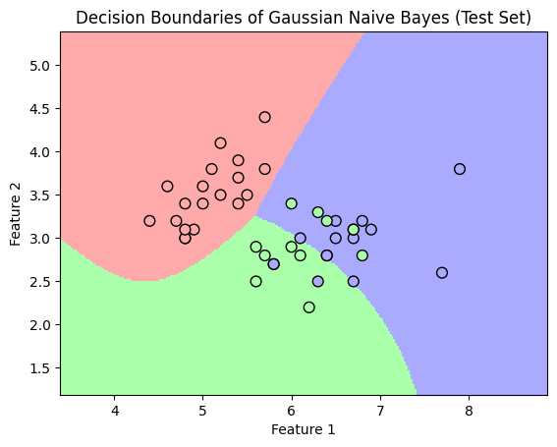
Naive Bayes
Naive Bayes is based on Bayes’ theorem, and assumes all features are independent given the class label.
Calculates probability of each class based on each feature independently
Assumes independence between features
Predictions are based on the class with the highest probability.
Strengths: Fast and efficient
Weaknesses: Independence assumption can limit accuracy by a LOT.

Slide 20
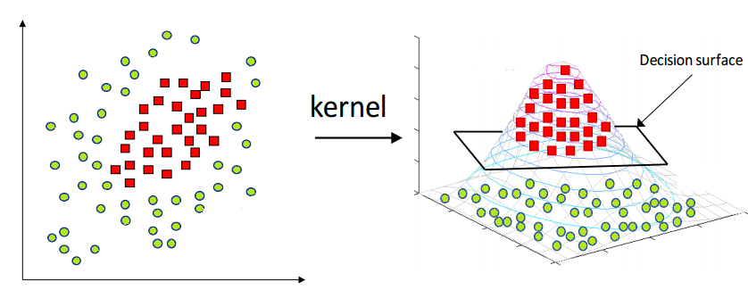
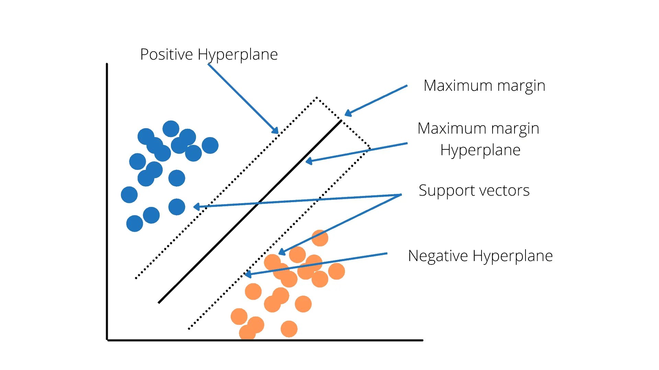
Support Vector Machine (SVM)
Support Vector Machine (SVM) finds a hyperplane that best separates classes by maximizing margin between classes’ boundary points.
For linearly separable data SVM finds a linear boundary
For non-linear data, SVM uses kernels to project data into higher dimensions.
Strengths: Effective in high dimensional spaces.
Flexible with various kernel functions; allows for both linear and non-linear classification
Weaknesses: Computationally intensive with large datasets, less interpretable

Slide 21
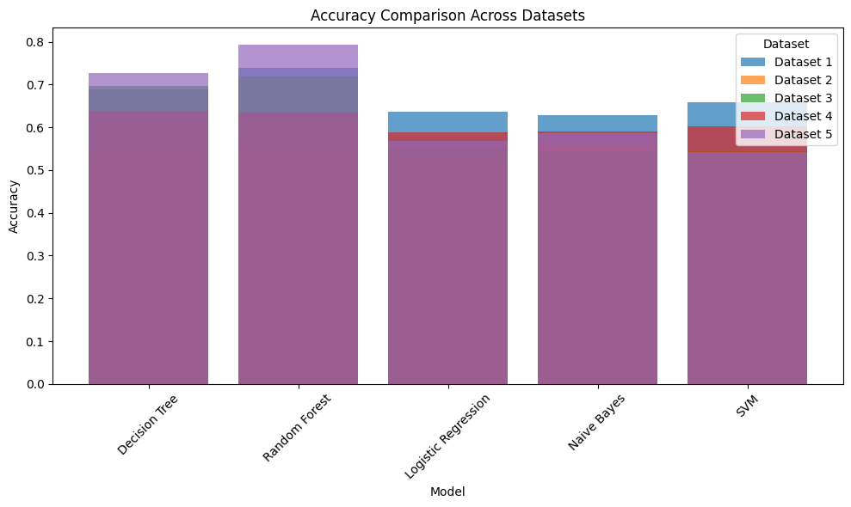
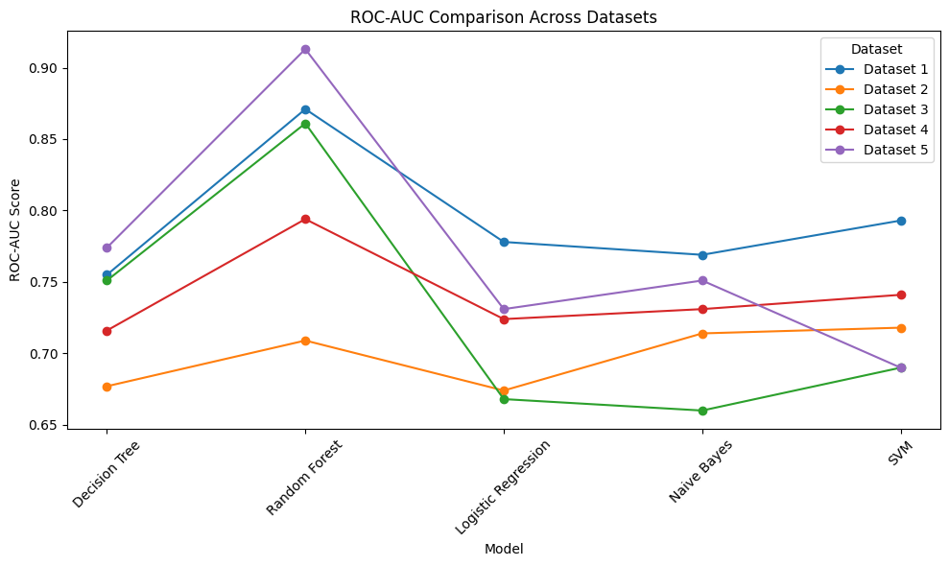
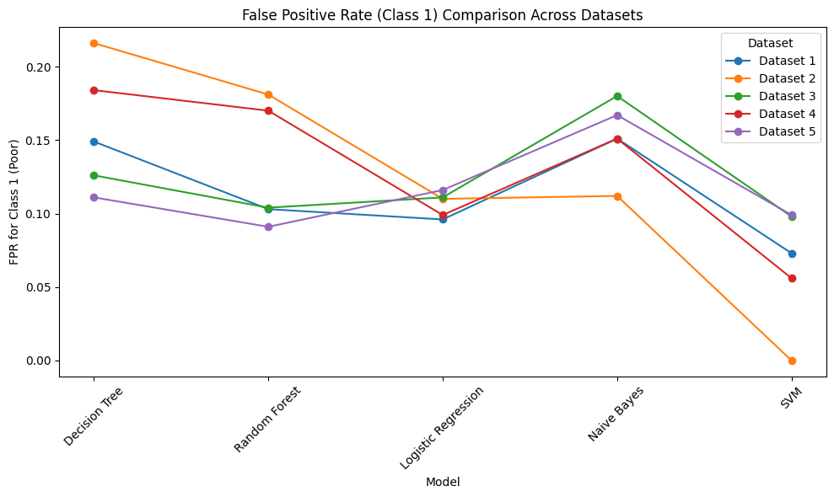
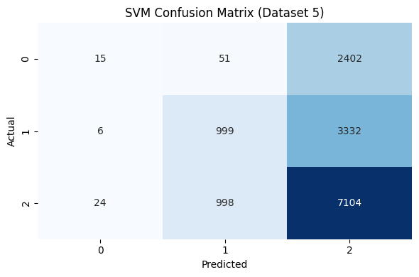

Slide 22
Discussion
Random Forest performed best, likely due to the ensemble approach which reduced the variance and captured more complex relationships
Decision Tree was decent, but it is prone to overfitting in tasks like these due to the high dimensionality of the data
Logistic Regression and Naive Bayes performed poorly due to underlying assumptions of linearity and feature independence, which clearly doesn’t hold for this dataset.
Future work can focus on hyperparameter tuning, further analyzing those non-linear features, and most importantly, introducing neural network models to significantly improve model performance and address class imbalance.

Slide 23
Thanks!

